Slide 1
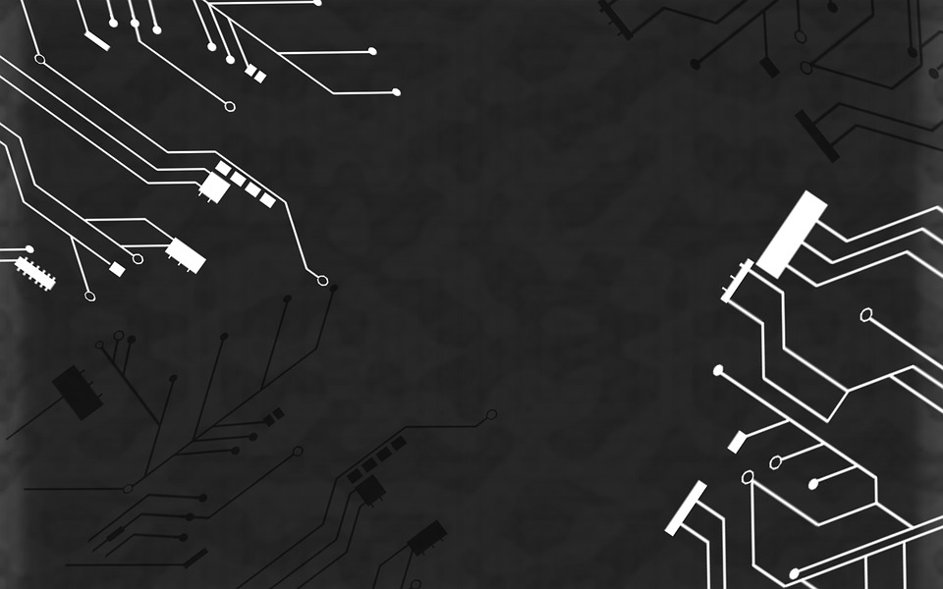

DIGIT RECOGNITION
GROUP MEMBERS
MD. MAQBOOL ALAM , HERITAGE INSTITUTE OF TECHNOLOGY
UNIVERSITY REG. NO. : 151260110084
REHAN NAWAZ , FUTURE INSTITUTE OF ENGINEERING & MANAGEMENTS
UNIVERSITY REG. NO. : 151480110160
APARNA SAHA , FUTURE INSTITUTE OF ENGINEERING & MANAGEMENTS
UNIVERSITY REG. NO. : 151480110139
ANTALINA DAS , FUTURE INSTITUTE OF ENGINEERING & MANAGEMENTS
UNIVERSITY REG. NO. : 151480110138

Slide 2
CONTENTS
AKNOWLEDGEMENT
PROJECT OBJECTIVE
PROJECT SCOPE
REQUIREMENT SPECIFICATION
DATABASE
APPLICATION WORK FLOW DIAGRAM
SCREENSHOTS
FUTURE SCOPE OF IMPROVEMENTS
CODE
BIBLIOGRAPHY

Slide 3
Acknowledgement
I take this opportunity to express my profound gratitude and deep regards to my faculty Prof. Arnab Chakraborty for his exemplary guidance, monitoring and constant encouragement throughout the course of this project. The blessing, help and guidance given by him/her time to time shall carry me a long way in the journey of life on which I am about to embark.
I am obliged to my project team members for the valuable information provided by them in their respective fields. I am grateful for their cooperation during the period of my assignment.
REHAN NAWAZ
MD MAQBOOL ALAM
APARNA SAHA
ANTALINA DAS

Slide 4
PROJECT oBJECTIVE
Digit Recognition is a popular computer vision problem which involves automatic recognition of digits:
To recognize handwritten digits correctly.
Using best algorithm for better performance.
To improve the accuracy of detection .

Slide 5
Project scope
The broad scope of the digit recognition project includes:
To split dataset into training and testing in proper threshold limit.
Feature Extraction
Selection of classifier
RandomForestClassifier, DecisionTreeClassifier, KNeighborsClassifier
has been used in proposed model .

Slide 6
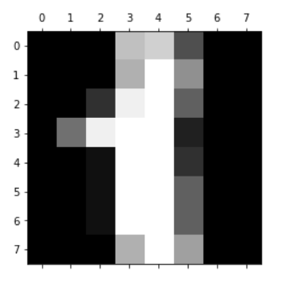
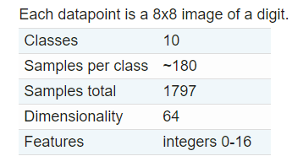
DATABASE
The digits dataset is one of datasets scikit-learn comes with that do not require the downloading of any file from some external website. The code below will load the digits dataset.
DATASETS
Figure (1)

Slide 7
WORK FLOW
TRAINING DATASETS
TRAINING MODEL
TRAINING LABELS
TRAINING FEATURES
TRAIN MODEL
PREDICTION
TESTING DATA
TRAINED MODEL
ACCURACY

Slide 8
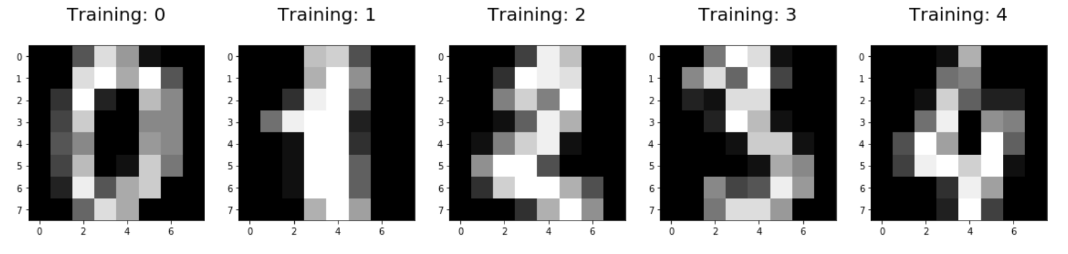
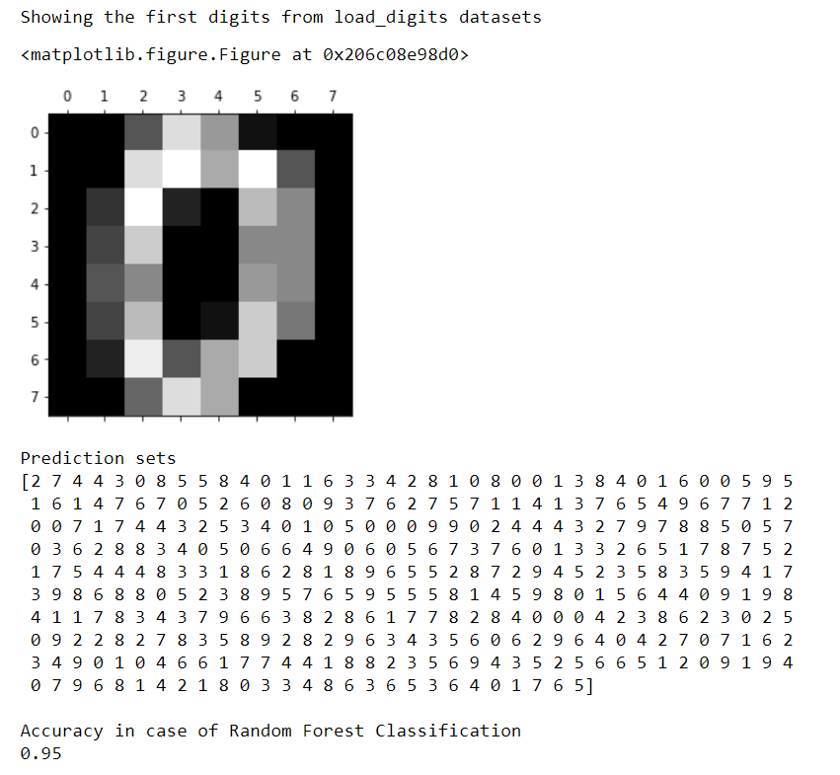
SCREENSHOTS
SHOWING THE FIRST DIGITS FROM “load_digits” DATASETS
PREDICTION =>
ACCURACY =>

Slide 9
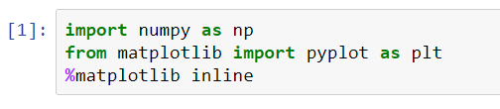
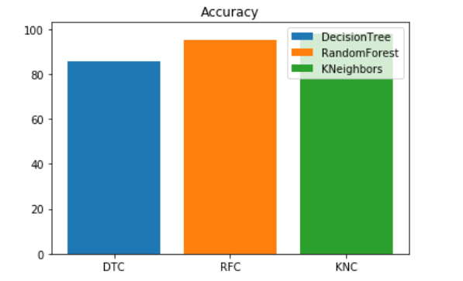
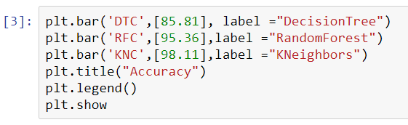
performance

Slide 10
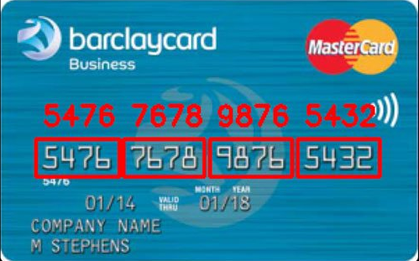
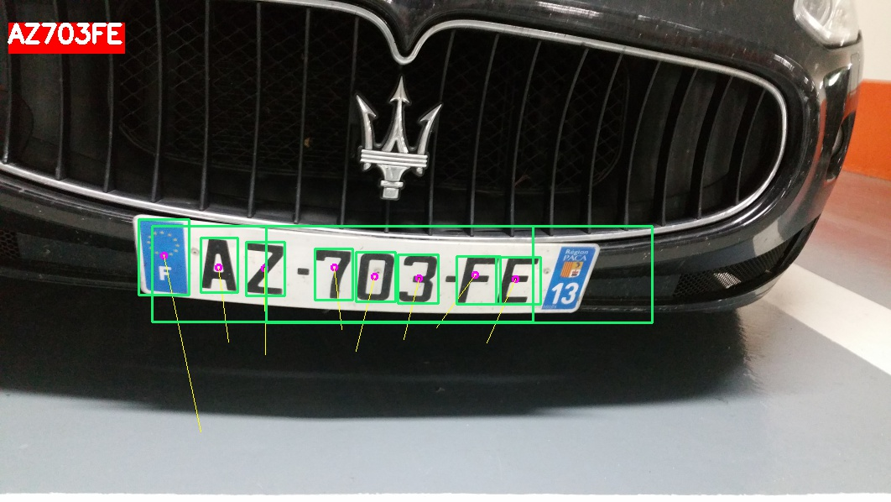
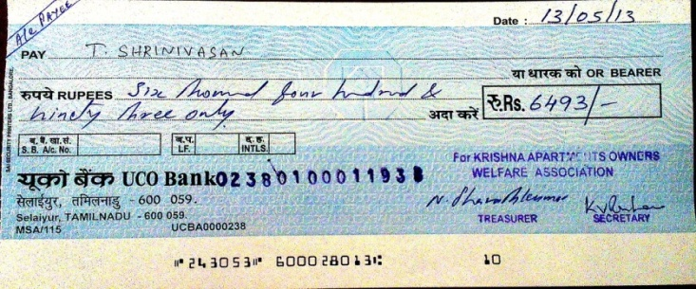
APPLICATION
Digit Recognition has many application in varies sectors. For exmple:
Banking
Courtesy Amount Recognition
Traffic Cameras /Number plate detection
Postal Mail Sorting
Formation of Data Entry

Slide 11
Future Scope of Improvements
The proposed algorithms can be modified further to improve accuracy.
New features can be added to improve the accuracy of recognition.
These algorithms can be tried on large database of handwritten digits.
The presented work focus on offline digit recognition so there is a scope for online digit recognition.

Slide 12
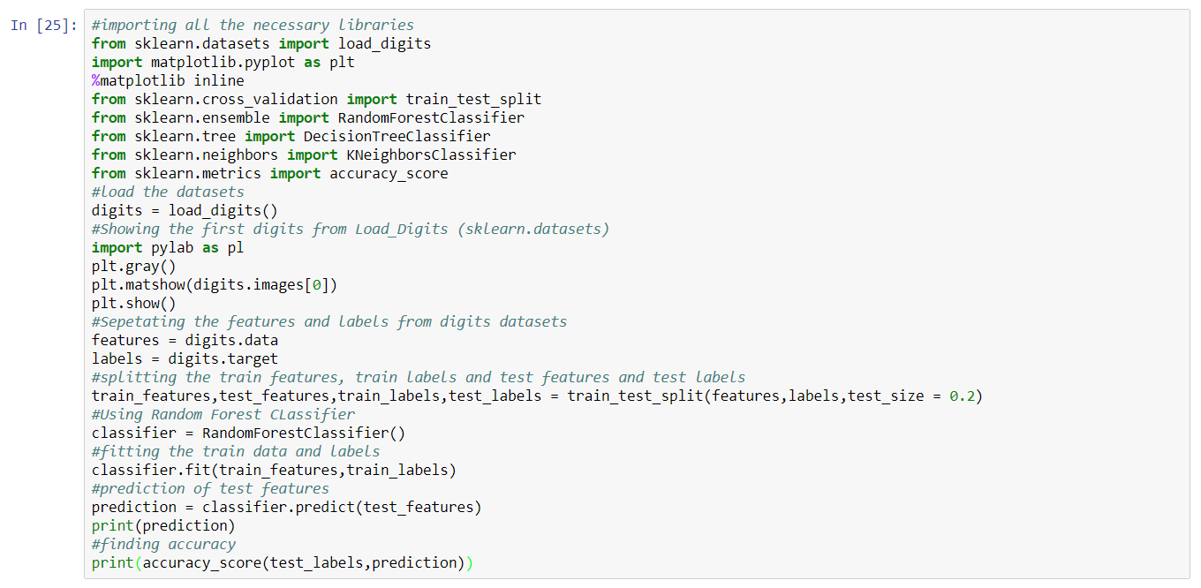
CODE

Slide 13
bibliography
"scikit-learn 0.19.1". Python Package Index.
Devi, V. Susheela and M. Narasimha Murty. Handwritten digit recognition using soft computing tools. In Soft Computing for Image Processing. Edited by S. K. Pal, A. Ghosh and M. K. Kundu. Berlin: Springer. 2000.

Slide 14

THANK YOU

